Slide 1
INTRODUCTION TO SOFTWARE ENGINEERING
LECTURE – 25
MAY 22, 2017

Slide 2
TOPICS COVERED
Distributed Software Engineering
Reuse Based Software Engineering
Configuration Management
CSD201 - Introduction to Software Engineering

Slide 3
Distributed Software Engineering
CSD201 - Introduction to Software Engineering

Slide 4
DISTRIBUTED SYSTEMS ISSUES
Transparency
Openness
Scalability
Security
Quality of Service
Failure Management
CSD201 - Introduction to Software Engineering

Slide 5
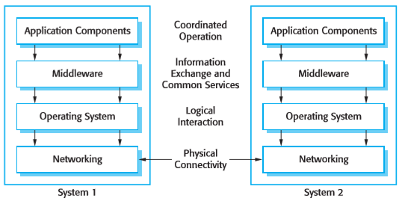
MIDDLEWARE
CSD201 - Introduction to Software Engineering

Slide 6

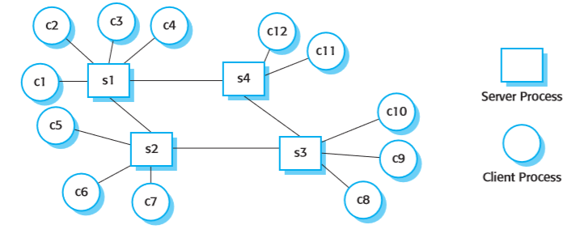
CLIENT-SERVER INTERACTION
CSD201 - Introduction to Software Engineering

Slide 7
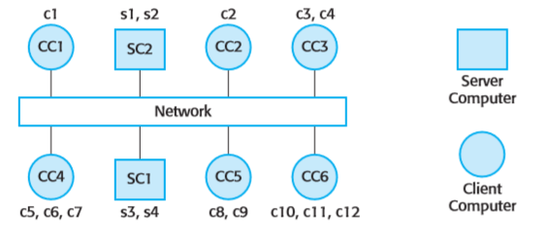
CLIENT-SERVER COMPUTING
CSD201 - Introduction to Software Engineering

Slide 8
REUSE-BASED SOFTWARE ENGINEERING
System reuse
  Complete systems, which may include several application programs may be reused.
Application reuse
  An application may be reused either by incorporating it without change into other or by developing application families.
Component reuse
  Components of an application from sub-systems to single objects may be reused.
Object and function reuse
  Small-scale software components that implement a single well-defined object or function may be reused.
CSD201 - Introduction to Software Engineering

Slide 9
THE RE-USE LANDSCAPE
Although reuse is often simply thought of as the reuse of system components, there are many different approaches to reuse that may be used
Reuse is possible at a range of levels from simple functions to complete application systems
The reuse landscape covers the range of possible reuse techniques
CSD201 - Introduction to Software Engineering

Slide 10
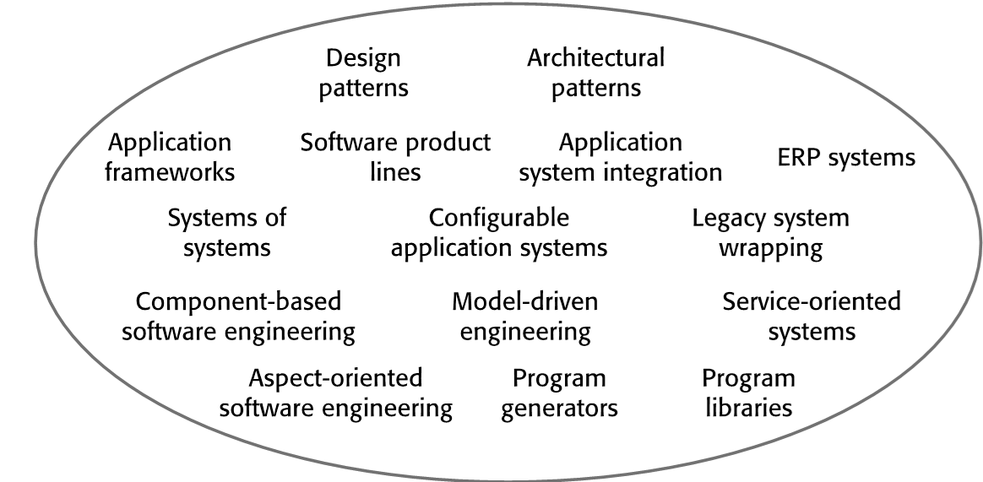
THE RE-USE LANDSCAPE
CSD201 - Introduction to Software Engineering

Slide 11
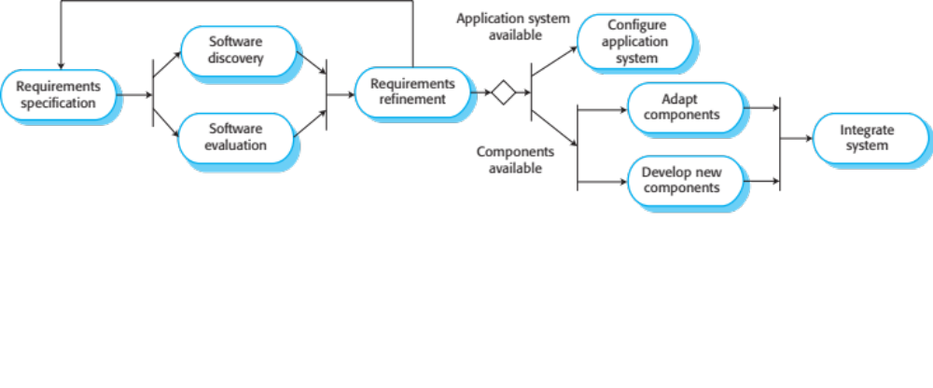
REUSE-ORIENTED SOFTWARE ENGINEERING
CSD201 - Introduction to Software Engineering

Slide 12
KEY PROCESS STAGES FOR ACQUISITION
Requirements specification
Software discovery and evaluation
Requirements refinement
Application system configuration
Component adaptation and integration
CSD201 - Introduction to Software Engineering

Slide 13
DOMAIN ENGINEERING FOR REUSE IN SOFTWARE ENGINEERING
Domain Engineering entails:
Domain Analysis
  Commonalities and differences of systems in a domain are discovered and recorded
Domain Implementation
  It means the use of information collected in domain analysis to create reusable components and new systems
CSD201 - Introduction to Software Engineering

Slide 14
CHARACTERISTICS OF GOOD DESIGN
Component independence
  High cohesion
  Low coupling
Exception identification and handling
Fault prevention and fault tolerance
Design for change
M1
M2
M3
CSD201 - Introduction to Software Engineering

Slide 15
COHESION
Definition
  The degree to which all elements of a component are directed towards a single task
  The degree to which all elements directed towards a task are contained in a single component
  The degree to which all responsibilities of a single class are related
Internal glue with which component is constructed
All elements of component are directed toward and essential for performing the same task
CSD201 - Introduction to Software Engineering

Slide 16
COUPLING
The degree of dependence such as the amount of interactions among components
No dependencies
Loosely coupled
some dependencies
Highly coupled
many dependencies
CSD201 - Introduction to Software Engineering

Slide 17
Q&A
CSD201 - Introduction to Software Engineering

